Slide 1
Model Architectures

Slide 2
Astroinformatics of galaxies and quasars: a new general method for photometric redshifts estimation

Slide 3
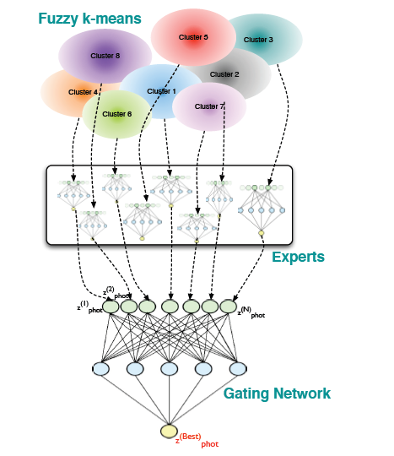
Weak-Gated Experts
Fuzzy K-Means
Experts
Neural Network
Output

Slide 4
Optical Photometry
4D Clustering
Optical Photometry:
clustered 4D feature space ->
train single expert on each cluster ->
gating network combines distinct outputs
Train Expert on Each Cluster
Train Expert on Each Cluster
Train Expert on Each Cluster
Gated Network
Combines
Distinct Output

Slide 5
Redshift of Quasars with Optical Photometry
4D Clustering
redshifts of quasars with optical photometry:
4D clustering -> experts trained on 8D features space generated
by 4 colors ->
rest similar to first experiment
(.15 for fuzzy clustering)
Experts Trained on 8D feature space
Experts Trained on 8D feature space
Experts Trained on 8D feature space
Gated Network
Combines
Distinct Output

Slide 6
Others
Redshift and UV experiments seem to be similar as others except 6 uncertainties from 5 SDSS optical filters 2 UV filters

Slide 7
AstroCLIP: Cross-Modal Pre-Training for Astronomical Foundation Models

Slide 8
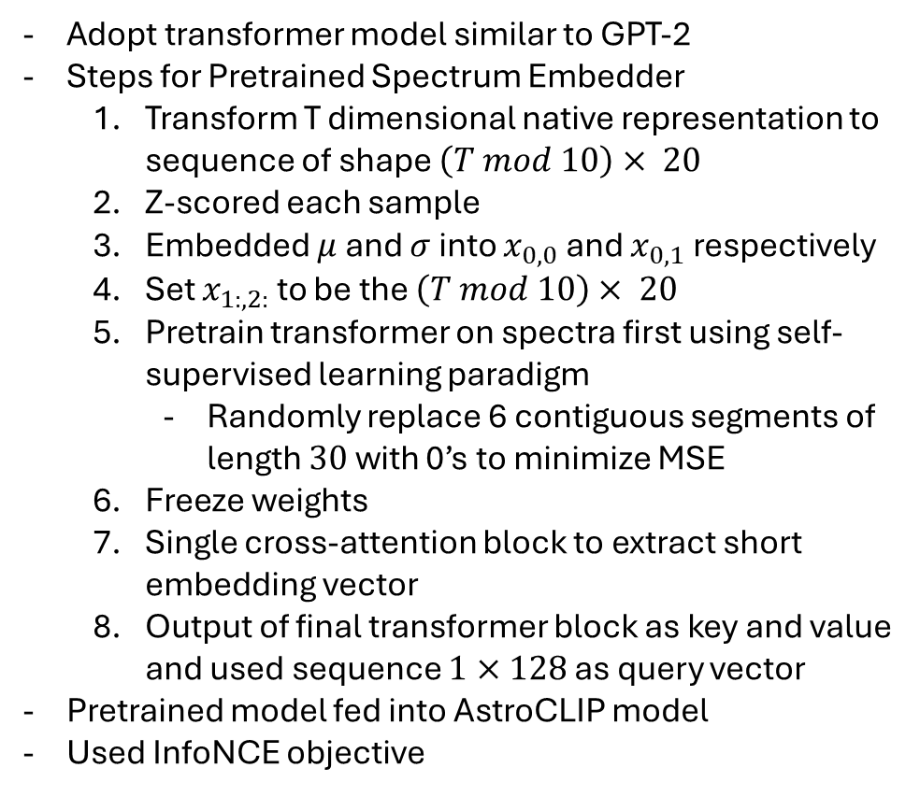
Pretrained Spectrum Embedder Model
Adopt transformer model similar to GPT-2
Steps for Pretrained Spectrum Embedder
Transform T dimensional native representation to sequence of shape $\left(T mod 10\right)× 20$
Z-scored each sample
Embedded $μ$ and $σ$ into $x_{0,0}$ and $x_{0,1}$ respectively
Set $x_{1:,2:}$ to be the $\left(T mod 10\right)× 20$
Pretrain transformer on spectra first using self-supervised learning paradigm
Randomly replace 6 contiguous segments of length $30$ with 0’s to minimize MSE
Freeze weights
Single cross-attention block to extract short embedding vector
Output of final transformer block as key and value and used sequence $1×128$ as query vector
Pretrained model fed into AstroCLIP model
Used InfoNCE objective
Pretrained Spectrum Embedder
AstroCLIP Model

Slide 9
Pretrained Image Embedder Model
Pretrained Image Embedder
Steps for Pretrained Spectrum Embedder
1. used pretrained image encoder from Stein et al
2. pretrained in self-supervised regime
Pretrained model fed into AstroCLIP model
Used InfoNCE objective
AstroCLIP Model

